Slide 1

REVERSE ENGINEERING ADVERTISEMENT
- YUKTHIKA . A

Slide 2
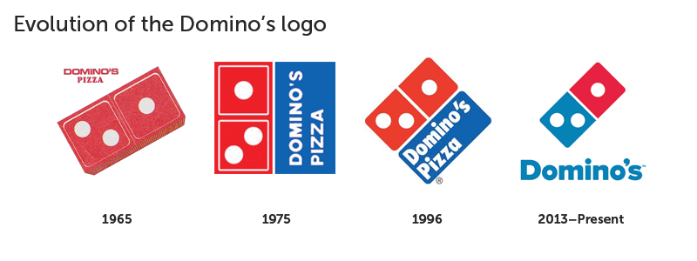

Slide 3
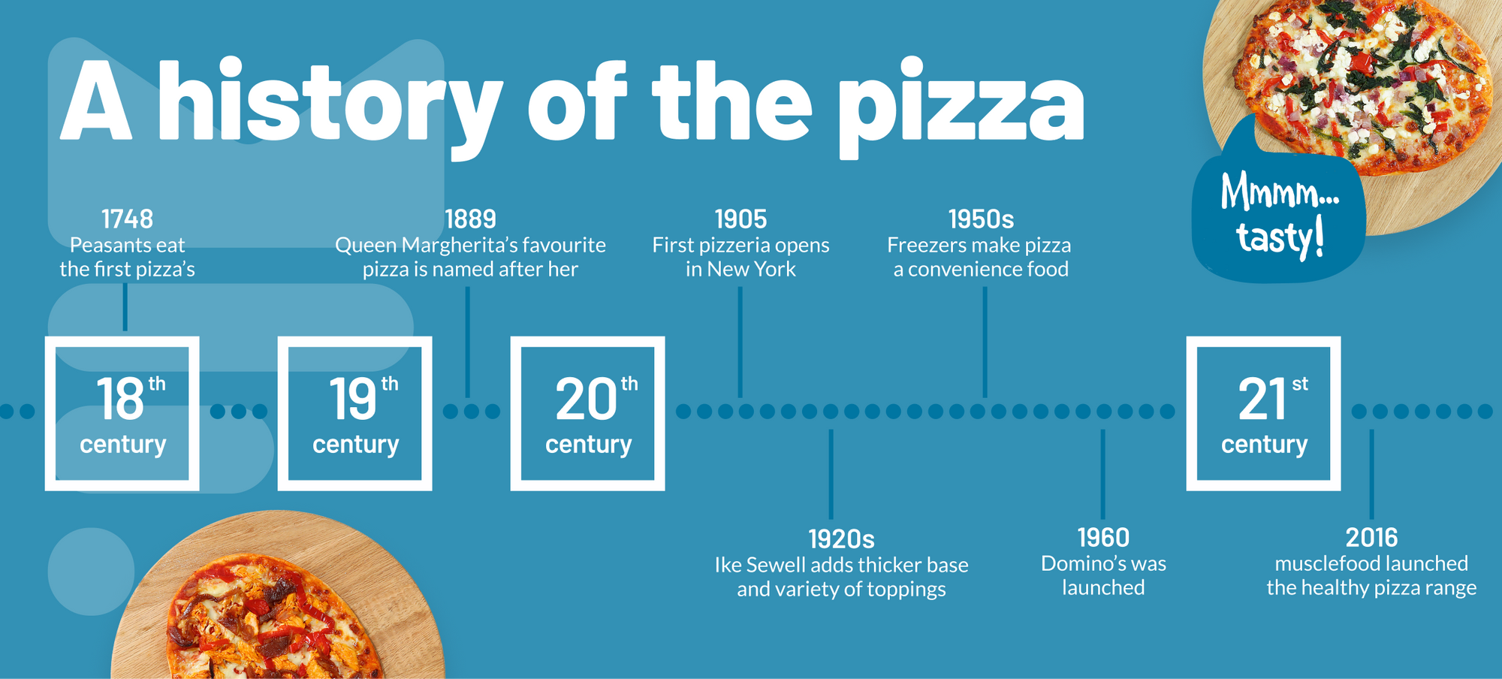

Slide 4
ABOUT DOMINO’S PIZZA
The Domino's menu varies by region. The current Domino's menu in the United States features a variety of Italian-American main and side dishes. Pizza is the primary focus, with traditional, specialty, and custom pizzas available in a variety of crust styles and toppings. In 2011, Domino's launched artisan-style pizzas. Additional entrees include pasta, bread bowls, and oven-baked sandwiches. The menu offers chicken and bread sides, as well as beverages and desserts
Domino's Pizza is the best selling brand of Pizza in India, known for its taste and also the largest pizza seller worldwide.

Slide 5
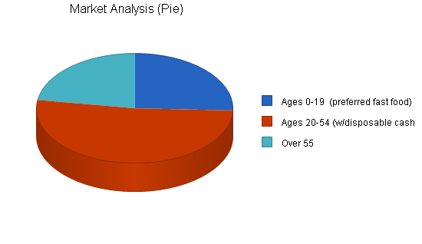
OBJECTIVE GOAL OF DOMINO PIZZA:
Includes adults 20 to 54 years old who socialize and have families.
Ages 4 to 19 prefer pizza over any fast food and often influence family dining decisions.
Hence it's target audience ranges from teens to young adults (15 to 27 year-olds) as this age group likes eating pizzas the most.

Slide 6
Study:
To know the consumer perception and preference about dominos products.
To know the customer satisfaction in pricing factors.
To know the customer satisfaction in delivery of their order.
To give suggestions to company to improve their service.

Slide 7
Data Collected:
Location : Chennai
S.NO | PARTICULARS | FREQUENCY
1. Age
 | Up to -25 | 36
 | 26-35 | 10
 | 36-45 | 4
 | Total | 50
2. Gender
 | Male | 32
 | Female | 18
 | Total | 50

Slide 8
INFERENCE:
HYPOTHESIS 1 H0
Null Hypothesis:
There is no significant difference between male and female respondents with respect to the factors of customer satisfaction towards Dominos Pizza.
HYPOTHESIS 2 H1
There is no association between gender and overall satisfaction towards Dominos Pizza. Hence P value is 0.29 So Null value accepted
S.NO | GENDER | HDS | DS | N | S | HS | TOTAL | CHI- SQUARE VALUE | P-VALUE
1. | MALE | 0 | 6 | 8 | 8 | 10 | 32 | 10.768 |  | 0.29
2. | FEMALE | 3 | 0 | 3 | 8 | 4 | 18

Slide 9
TEST ANALYSIS PERFORMED: Y=SALES IN DISCRETE X=AGE GROUP IN CONTINUOUS

Slide 10
From the graph we can Infer that:
1.Teenagers in the age group of 25 and below most
likely prefer to eat pizza(Both Boys and Girls).
2.The category of age people between 26-35 much more
have craving for pizza Compared to that of people in
36-45.
3.People at the age of 36-45 do not have much interest
on pizza compared to other Two category of people.

Slide 11
CONCLUSION:
Customer satisfaction towards fast food restaurant was significantly related to behavioral intentions of customers.
Examined the customer satisfaction towards Domino's Pizza in Chennai by
employing percentage analysis
It was found that most of the respondents were satisfied with service followed by the quality and taste.

Slide 12
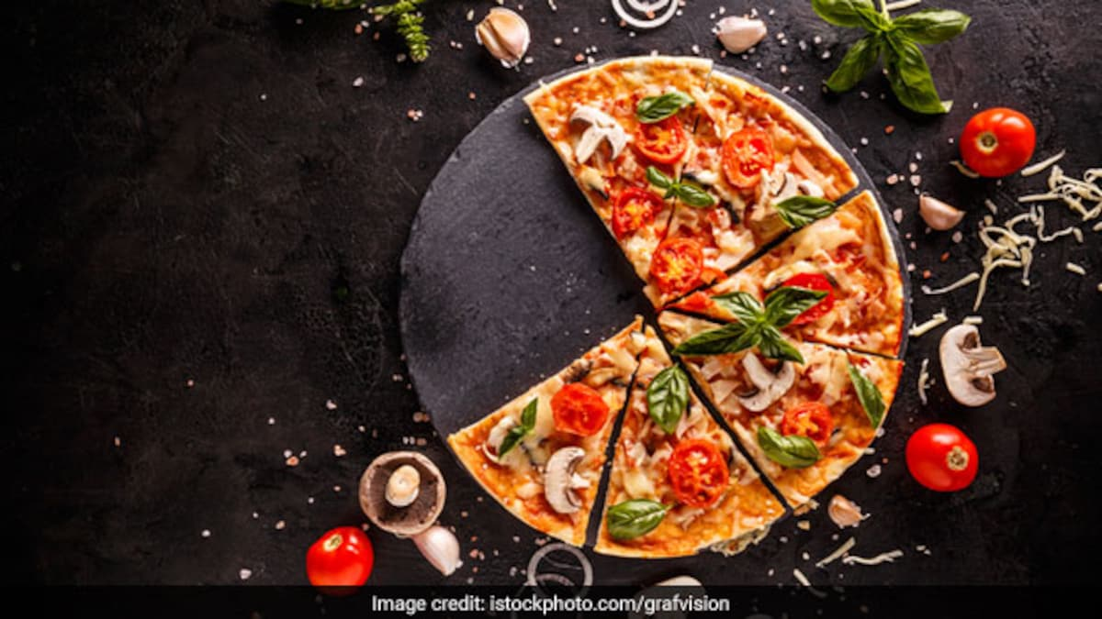
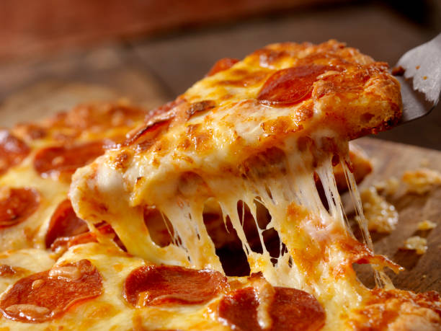
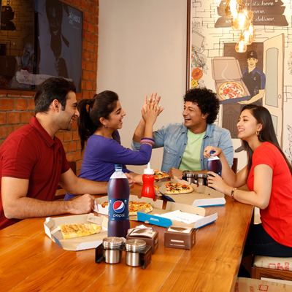

THANK YOU

